Slide 1
Terrain Classification using Transfer Learning on Hyperspectral Images: Review and Comparative study
Submitted By:
Prabhakar Kumar (IRM2017008)
Nikhil Goyal (IRM2017005)
Neelaksh Trehan (IIM2017002)
Under the Guidance of:
Prof. O. P. Vyas
IIIT Allahabad

Slide 2
ABSTRACT
The CNN and the MLP have been proven to be an effective method of image classification. However, they suffer from the issues of long training time and requirement of large amounts of the labeled data, to achieve the expected outcome. These issues become more complex while dealing with hyperspectral images.
To decrease the training time and reduce the dependence on large labeled dataset, we propose using the method of transfer learning. The hyperspectral dataset is preprocessed to a lower dimension using PCA, then deep learning models are applied to it for the purpose of classification. The features learned by this model are then used by the transfer learning model to solve a new classification problem on an unseen dataset.
A detailed comparison of CNN and multiple MLP architectural models is performed. The training time is reduced to greater extent by applying the transfer learning approach rather than just approaching the problem by directly training a new model on large datasets, without much affecting the accuracy.

Slide 3
INTRODUCTION
A normal image has 3 channels of pixel values namely, Red, Green and Blue (RGB). While in the case of hyperspectral images, tens to hundreds of narrow colour channels are recorded.
Hyperspectral image (HSI) is an image cube made up of hundreds of spatial images. By combining all these narrow colour channels we are able to process different qualities of our target image.
CNNs represent a huge breakthrough in image recognition. The use of CNN for HSI classification is also visible in recent works.
While CNNs have become a standard model for the image classification, the Multi-Layer Perceptron (MLP) models are also extensively used for the HSI classification, especially when the computing resources are limited.
However, in the case of HSIs, training time is long for the deep learning models, and the demand for the marked data is large.
The training data in the same feature space or with same distribution as the future data can’t surely avoid the over-fitting, when the availability of labeled data is low.
The high dimensionality and lack of data samples make HSIs a highly complex task to classify.
Transfer learning can help in such situations as related data in different domains can be used to expand the knowledge.
Transfer learning works by extracting useful information from data in a related domain and transferring it to be used in the target domain.
Transfer learning would help to reduce the training time as well as help us overcome the obstruction of having fairly small dataset, given the high dimensionality.

Slide 4
MOTIVATION
The motivation for doing this project was primarily an interest in undertaking a challenging project in an interesting area of research.
With the advent of modern remote sensing technology it has become possible to obtain much higher resolution and much better quality satellite images than everbefore, as such it is important to scale the software architecture that processes these images to achieve maximal utilization. One category of satellite images is hyperspectral images, consisting of many more channels than ordinary RGB images.
Human eyes have limits to their capabilities of perceiving wavelengths of the electromagnetic spectrum. However, digital processing tools are not bound by the same limitations, and hence can process the information contained within HSI and produce greater knowledge about entities within the image. All this intrigues to further explore the hyperspectral images.

Slide 5
PROBLEM DEFINITION
The Hyperspectral Image forms a three dimensional data (i.e. is in the form of a data cube). In the Hyperspectral Dataset, we have an image along with its correct labels, also known as ground truth values.
Since the availability of the labeled Hyperspectral data is low, so to avoid overfitting and also to reduce the training time, we explore the transfer learning approach.
The deep learning models will be trained for the classification of the Indian Pines dataset. These models will then be used to transfer the knowledge extracted from the Indian Pines dataset, i.e. they will act as a pre-trained model for the classification task of the University of Pavia dataset.
The project aims to compare the different deep learning models coupled with transfer learning, to perform classification of the Hyperspectral Images (the University of Pavia image in our case).
Datasets:
The Indian Pines (IP) :
This dataset has an image with 145x145 spatial dimensions and 224 spectral bands in the wavelength range of 400 to 2500 nm, out of which 24 spectral bands covering the region of water absorption have been discarded. The groundtruth available is designated into 16 classes of vegetation.
The University of Pavia (UP) :
This dataset consists of an image with 610x610 spatial dimension pixels with 103 spectral bands in the wavelength range of 430 to 860 nm. The ground truth is divided into 9 urban land-cover classes.

Slide 6
LITERATURE REVIEW
Hyperspectral data possess complex characteristics which transform the task of accurate classification into an interesting and challenging problem. Recent developments in the field of machine learning have identified deep learning to be a powerful tool to achieve feature extraction and address nonlinear problems. Considering these factors, deep learning has also been introduced to classify HSIs.
In their survey paper, Ying Li et al., have systematically reviewed several pixel-wise and scene-wise HSI classification approaches which use DL methods. The comparative analysis on CNNs, Stacked autoencoders and Deep belief networks (DBN) shows CNNs to be most accurate.
The Multi-Layer Perceptron (MLP) have also been extensively used for classification of the multispectral as well as hyperspectral images. They are relatively fast to train and produce comparable results to the CNNs. A study by Beatriz et al. has focused on the time optimization for the classification of HSIs by MLP. They proposed 5 different architectures for MLP and compared them with the state of the art SVM model. They also proposed a parallel programming scheme for training the MLP.
For using classifiers like KNN and SVMs one requires a more in-depth knowledge of HSI, on the other hand Deep Learning techniques like neural nets allow us to extract complicated features from hidden layers without too much pre-processing of the data.
A variation can be using SVM in the last layer of the CNN model instead of the traditional softmax layer (SVM-CNN model). The resultant model would now require less training time, but this comes at the cost of accuracy.

Slide 7
LITERATURE REVIEW
The paper by Roy et al. shows the advantages of using Hybrid Spectral Net (Hybrid SN), a 3D-2D CNN instead of using pure 2D or pure 3D CNN. The pure 2D CNN on its own is not able to extract features regarding the spectral dimensions while pure 3D CNN would become computationally expensive to use and it performs worse for classes having similar textures over many spectral dimensions.
The HSI data cube is divided into small overlapping 3D patches, their truth labels are decided by the label of the centered pixel. The 2D convolution is applied once before the flatten layer to extract abstract high level features. The research paper confirms the superiority of the proposed method by performing experiments over three benchmark datasets. The proposed model is shown to be computationally more efficient than the pure 3D CNN model.
The paper by Xuefeng Jiang et al. emphasizes a new technique of feature extraction using transfer learning which significantly lowers the training time of the CNN used and reduces its dependency on large labelled datasets. Ke Li et al. have also explored a transfer learning approach for hyperspectral image classification using deep belief network.
CNN-based frameworks can achieve high accuracy in an object classification task. But when coupled with transfer learning, they can give high performance in detection tasks as well, while reducing the required training time and computing resources.
Taking inspiration from these papers we use a transfer learning approach coupled with CNN and MLP models, and perform a comparative analysis in the end.

Slide 8
PROPOSED METHODOLOGY
Dataset Preparation
Two datasets, namely the Indian Pines and the Pavia University, were used, the Indian Pines for training the CNN model from which the CNN stump was extracted to be trained on the Pavia dataset.
The data used for initial model training was the Indian Pines, collected by the AVIRIS sensor over the Indian Pines test site in North Western Indiana.
The Pavia University dataset was used to test the model built using transfer learning. It was acquired by the ROSIS sensor over Pavia in Northern Italy.
Before model training both datasets were subjected to PCA for dimensionality reduction, which reduces the spectral dimension to 30. This is done so as to facilitate faster training time for the models and reduces the memory cost.
Before feeding the dataset for training we need to prepare multiple distinct image cubes from the images, and the size of the image cubes behaves as a hyper-parameter. For this purpose the image cubes are taken of size 5x5x30. Further we also need to flatten the given input image, since unlike a CNN model where we can directly feed an image, a MLP model requires a flat matrix of input parameters.

Slide 9
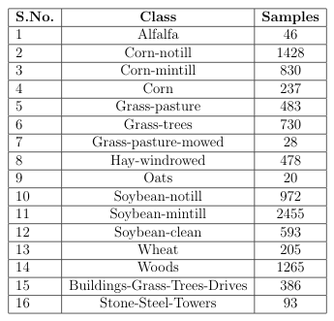
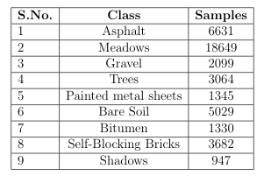
PROPOSED METHODOLOGY
Dataset Preparation
Ground-truth classes for the Indian Pines
Ground-truth classes for the Pavia University

Slide 10
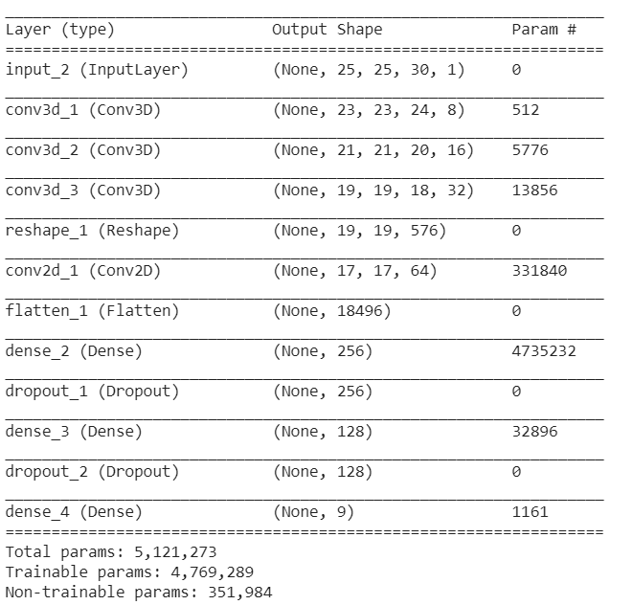
PROPOSED METHODOLOGY
Firstly, a CNN model was trained on the Indian Pines dataset. This CNN uses both 3D and 2D convolution operations to leverage feature map extraction from both the spatial and the spectral dimensions.
The model is trained with the 5x5x30 data-cubes obtained from pre-processing the data which is shuffled and split into a train to test ratio of 70:30. The training set is then used for training the CNN.
The first 3 layers are convolution 3D layers, which consist of 8, 16 and 32 filters respectively. After this, a convolution 2D layer is applied which consists of 64 filters and the filter size of 3 by 3. This is the 4th convolution layer. The output from this convolution layer is then flattened (i.e. converted all the activations into 1-D vector).
This is then fed into the Artificial Neural Net type architecture that mainly consists of fully connected dense layers with ReLU activations.We have made use of Leaky ReLU activation in the 2 dense layer, and finally an output layer that uses a Softmax Activation function for class prediction.
The CNN stump of the model i.e. the convolutional and pooling layers are extracted and the later layers i.e. the fully connected layers and the softmax layers are stripped. To this convolutional stump, a new set of layers is connected, 3 fully connected layers with ReLU activation and a softmax layer of 9 units are appended.
The patches obtained from the Pavia dataset are then split into the training and the test set in a ratio of 40:60. The model is trained for 3 epochs.
CNN Model
Summary of CNN model

Slide 11
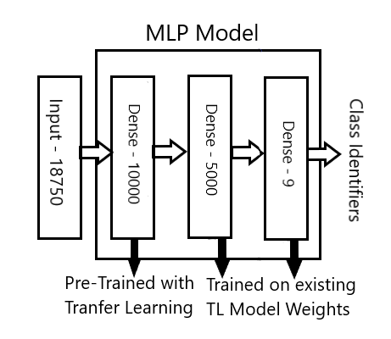
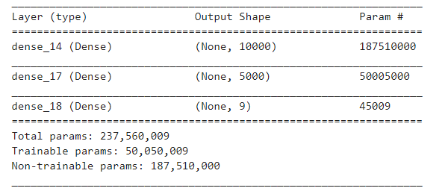
PROPOSED METHODOLOGY
MLP Model 1
The MLP model used here is a standard MLP model with three dense layers with 10000, 5000 and 9 layers respectively.
The model firstly was trained on Indian Pines dataset and then the last two layers were deleted while making use of the model for prediction on Pavia dataset using transfer learning.
The first and the second layers are activated using the ReLu activation function while the last layer that gives the Class identifiers is activated using a SoftMax activation function.
The initial model was trained for 20 epochs with a batch size of 128, while on the other hand when the model was used for transfer learning and trained on Pavia dataset only 10 epochs with 128 batch size were performed.
Diagrammatic representation of the model
Summary of the model

Slide 12
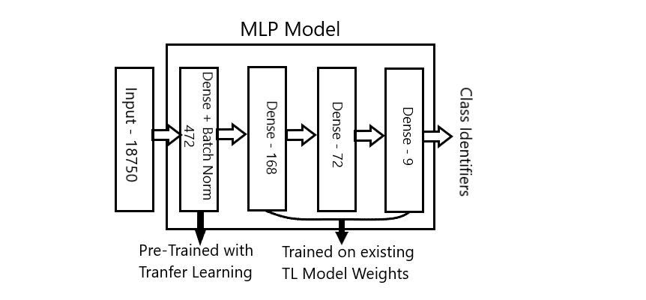
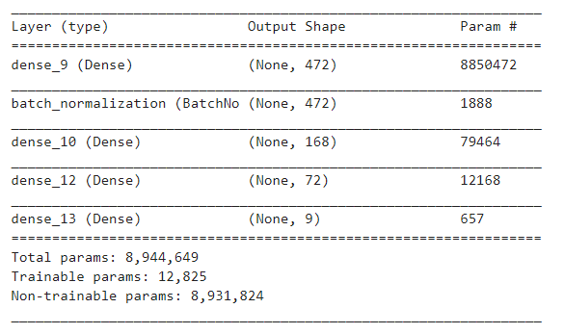
PROPOSED METHODOLOGY
Since there is no perfect model that can be defined for any Neural Network problem hence the feasibility of the solution and model depends on whether the error generated by the model is under the permissible parameters of the problem.
In this model the initial training was done in the Indian Pines dataset with just two Hidden Layers. Later when Transfer learning was performed, the last layer along with its batch normalization extension was chopped off, and three more layers were added. The first layer is a Dense Layer of 472 perceptrons, followed by a Batch Normalisation layer.
This first layer was left as it is during transfer learning, and three more layers were added with 168, 72 and 9 perceptrons respectively. These layers were the trainable layers that were trained during transfer learning.All these perceptron layers are activated using a ReLu activation function.
The initial model was trained for 20 epochs with a batch size of 128, while on the other hand when the model was used for transfer learning and trained on Pavia dataset only 10 epochs with 128 batch size were performed.
MLP Model 2
Diagrammatic representation of the model
Summary of the model

Slide 13
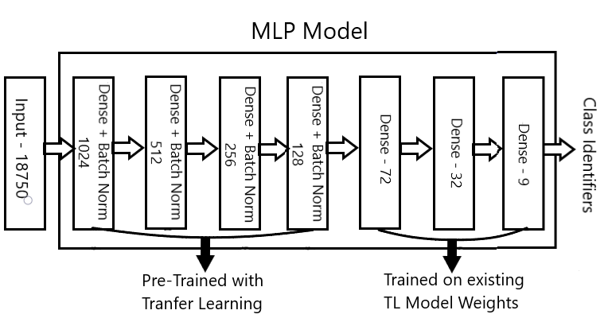
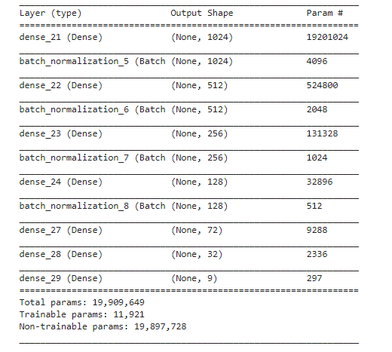
PROPOSED METHODOLOGY
This model is an extension of the Model 2 with a greater number of pre-trained layers but with lesser number of perceptrons, as models also need to be compared by scaling them horizontally, i.e., adding more layers but reducing the strength of each layer.
This model was also first trained with 5 Hidden layers on Indian Pines dataset, but when transfer learning was applied its last two layers were chopped off, and three new dense layers were added. The layers from the saved models were not trained on the Pavia dataset, while the three dense layers were trained.
The pretrained layers consisted of Dense layers with 1024, 512, 256 and 128 perceptrons, with each layer being followed by an appropriate Batch Normalization layer. All the perceptron layers are activated using a ReLu activation function.
The initial model was trained for 20 epochs with a batch size of 128, while on the other hand when the model was used for transfer learning and trained on Pavia dataset only 10 epochs with 128 batch size were performed.
MLP Model 3
Diagrammatic representation of the model
Summary of the model

Slide 14
SOFTWARE
REQUIREMENTS
HARDWARE
REQUIREMENTS
Python 3.7
OS supporting Google Chrome Web Browser
Google Collab
Tensorflow, Keras
NumPy, pandas, scikit-learn, Matplotlib python libraries
Spectral - python module for processing Hyperspectral Image Data.
Machine supporting GPU for training the Transfer Learning model
Core i5 or i7 CPU
Minimum 8 GB RAM

Slide 15
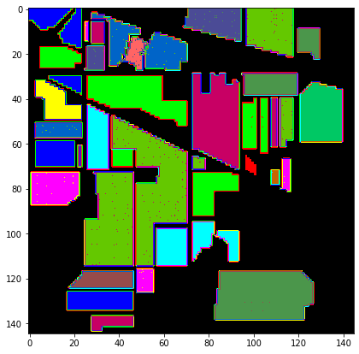
RESULTS
CNN Model
Firstly, the Indian Pines dataset is applied to the CNN model.
Test set accuracy came out to be 99.31% which is quite high, but the model had to be trained for 100 epochs which took around 15 minutes to run on Google Colaboratory.
This trained model was saved to be used for transfer learning purposes in future.
Ground Truth of Indian Pines
Prediction of Indian Pines by CNN model

Slide 16
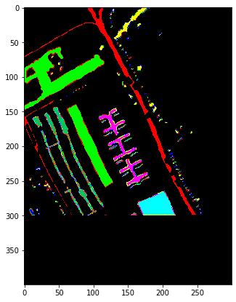

RESULTS
CNN Model
For training over the Pavia University dataset, the above model was loaded and the last few layers were popped off, as they were specifically trained on Indian Pines Dataset.
New layers were added so that they could be trained specifically on the Pavia University dataset.
The test set accuracy for the Pavia University dataset came out to be 99.93% and it had to be trained only for 3 epochs that took approximately 30 seconds, which is significantly better than the last model.
Ground Truth of Pavia University
Prediction of Pavia University

Slide 17
RESULTS
MLP Models
Results obtained by all the MLP models have been presented in the following table:
Model | MLP Model 1 | MLP Model 2 | MLP Model 3
Layers | 3 | 4 | 7
Architecture | (18750,10000,5000,9) | (18750,472,168,72,9) | (18750,1024,512,256,128,72,32,9)
Trainable Parameters | 50,050,009 | 12,825 | 11,921
Indian Pines epochs required | 20 | 20 | 20
Indian Pines Test Accu. | 99.70% | 99.95% | 99.90%
Indian Pines Avg. Accu. | 99.59% | 99.96% | 99.78%
Pavia epochs required | 10 | 10 | 10
Pavia Test Accu. | 96.78% | 98.71% | 98.19%
Pavia Avg. Accu. | 95.37% | 97.84% | 96.83%

Slide 18
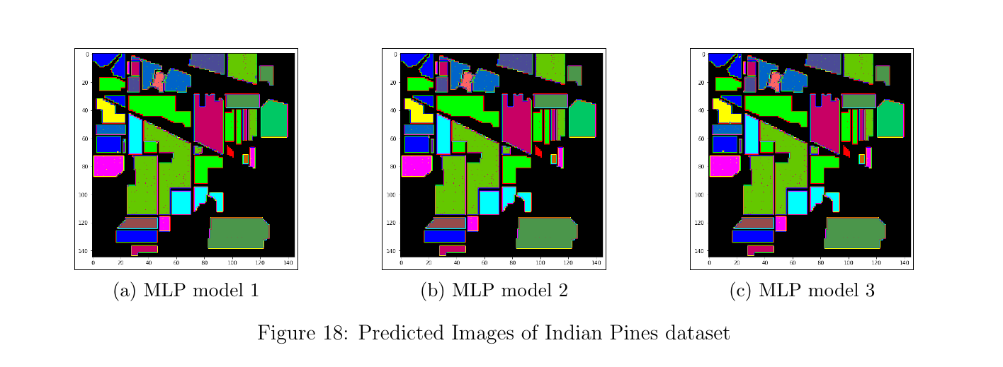
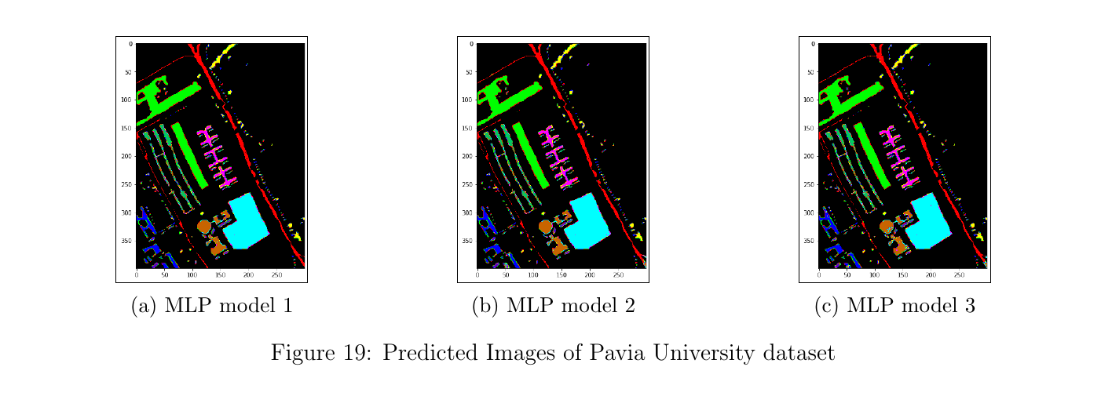
RESULTS
MLP Models

Slide 19
CONCLUSION
The MLP based models are straight-forward and are used in a wide range of image classification objectives. Unlike the CNN, they require a smaller training time since there are no tasks to capture the spatial features like convolution or pooling. Scaling the MLP architecture, either vertically or horizontally does lead to increase in the accuracy of the model, at the cost of time, but there is an upper limit to it, after which the model starts to experience overfitting and performs worse in the case of transfer learning. These facts were evidently seen with the detailed comparison of the three different MLP models that were implemented and discussed.
The use of transfer learning substantially decreases the training time required for the model, on larger datasets like Pavia by extracting weights and knowledge from smaller datasets like the Indian Pines dataset. The crux of transfer learning lies in fact that we take advantage of the inner layers trained in the previous model and use it’s general information (in our case about the hyperspectral images) to train the outermost few layers. Thus, saving time by not having to train the inner layers again.
One more argument that arose was whether a CNN based transfer learning model or a MLP based transfer learning model.The decision of which model to prefer is based on the application and objective and also may vary with the available resources. In case when the terrain classification is to be used for purposes like agricultural research, the spatial features need to be taken care of and hence a CNN based model would work better in this case. On the other hand, in applications involving military remote sensing the spectral features overlook the spatial ones, and hence the MLP based model should be preferred over CNN in this case.

Slide 20
REFERENCES
L. Shao, F. Zhu, and X. Li. “Transfer Learning for Visual Categorization: A Survey”. en. In:IEEE Transactions on Neural Networks and Learning Systems 26.5 (May 2015), pp. 1019–1034.
S. K. Roy et al. “HybridSN: Exploring 3-D–2-D CNN Feature Hierarchy for Hyperspectral Image Classification”. In:IEEE Geoscience and Remote Sensing Letters17.2 (2020), pp. 277–281.
S. Balakrishnan et al. “Deep Learning for Hyperspectral Image Classification on Embedded Platforms”. In:2018 IEEE International Conference on Image Processing, Applications and Systems (IPAS). 2018, pp. 187–191.
Indian Pines. url:http://www.ehu.eus/ccwintco/index.php?title=Hyperspectral_Remote_Sensing_Scenes.
Pavia University. url:http://www.ehu.eus/ccwintco/index.php?title=Hyperspectral_Remote_Sensing_Scenes.
Ying Li et al. “Deep learning for remote sensing image classification: A survey”. In: WIREs Data Mining and Knowledge Discovery 8.6 (2018), e1264. Doi: 10.1002/widm.1264.
Shutao Li et al. “Deep Learning for Hyperspectral Image Classification: An Overview”. In:IEEE Transactions on Geoscience and Remote Sensing 57.9(Sept. 2019), pp. 6690–6709. issn: 1558-0644. Doi: 10.1109/tgrs.2019.2907932. Url: http://dx.doi.org/10.1109/TGRS.2019.2907932.

Slide 21
REFERENCES
Yanan Luo et al. HSI-CNN: A Novel Convolution Neural Network for Hyperspectral Image. 2018. arXiv:1802.10478 [cs.CV].
W. d. Silva et al. “Multispectral Image Classification Using Multilayer Perceptron and Principal Components Analysis”. In:2013 BRICS Congress on Computational Intelligence and 11th Brazilian Congress on Computational Intelligence. 2013, pp. 557–562.
Beatriz P. Garcia-Salgado, Volodymyr I. Ponomaryov, and Marco A. Robles-Gonzalez. “Parallel multilayer perceptron neural network used for hyperspectral image classification”. In:Real-Time Image and Video Processing 2016. Ed.by Nasser Kehtarnavaz and Matthias F. Carlsohn. Vol. 9897. International Society for Optics and Photonics. SPIE, 2016, pp. 141–153.doi:10.1117/12.2227329. url:https://doi.org/10.1117/12.2227329.
Abien Fred Agarap. An Architecture Combining Convolutional Neural Network(CNN) and Support Vector Machine (SVM) for Image Classification. 2017. arXiv: 1712.03541 [cs.CV].
X. Jiang et al. “Hyperspectral Image Classification With Transfer Learning and Markov Random Fields”. In: IEEE Geoscience and Remote Sensing Letters 17.3 (2020), pp. 544–548.
Ke Li et al. “A Novel Method of Hyperspectral Data Classification Based on Transfer Learning and Deep Belief Network”. In: Applied Sciences 9 (Apr.2019), p. 1379. doi: 10.3390/app9071379.
P. Pooyoi et al. “Snow Scene Segmentation Using CNN-Based Approach With Transfer Learning”. en. In: 2019 16th International Conference on Electrical Engineering/Electronics, Computer, Telecommunications and Information Technology (ECTI-CON. Pattaya, Chonburi, Thailand, 2019, pp. 97–100.

Slide 22
THANK YOU !!

